Slide 1
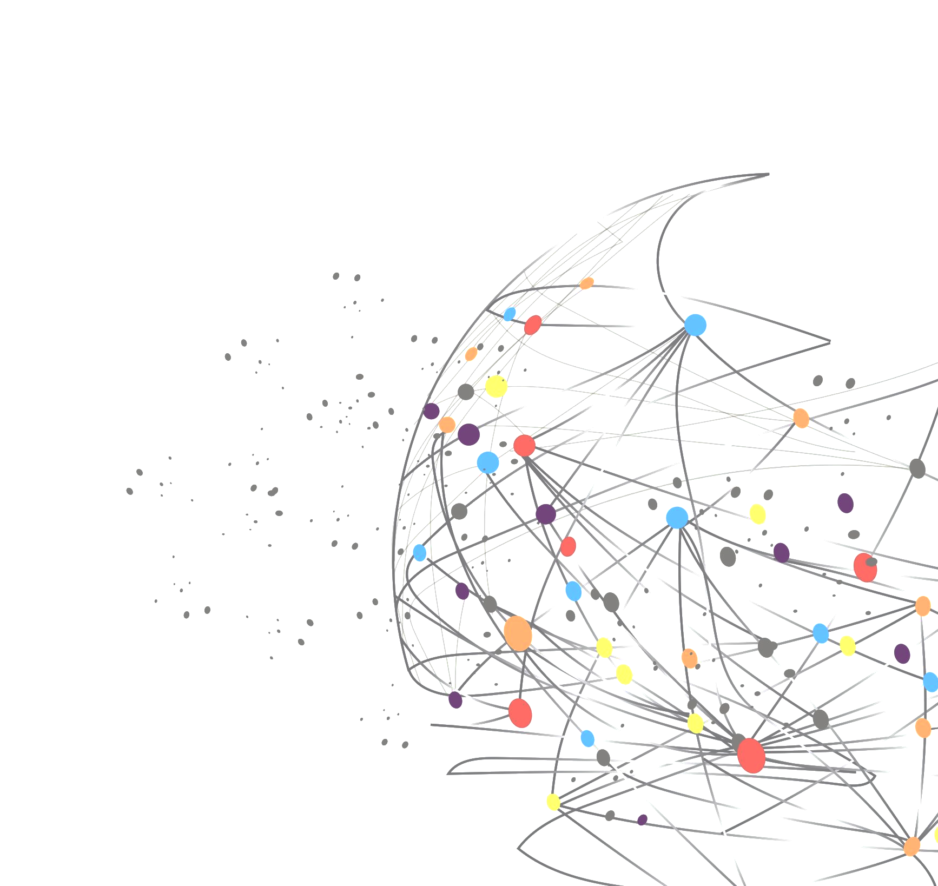
Split-Treatment Analysis to Rank Heterogenous Causal Effects for Prospective Interventions
Yanbo Xu (Georgia Tech)
Divyat Mahajan (Microsoft Research India)
Liz Manrao (Microsoft)
Amit Sharma (Microsoft Research India)
Emre Kıcıman (Microsoft Research AI)

Slide 2
Outline
Motivation
Identification by Split-Treatment
An Analysis Pipeline using Split-Treatment
Experiment and Results

Slide 3
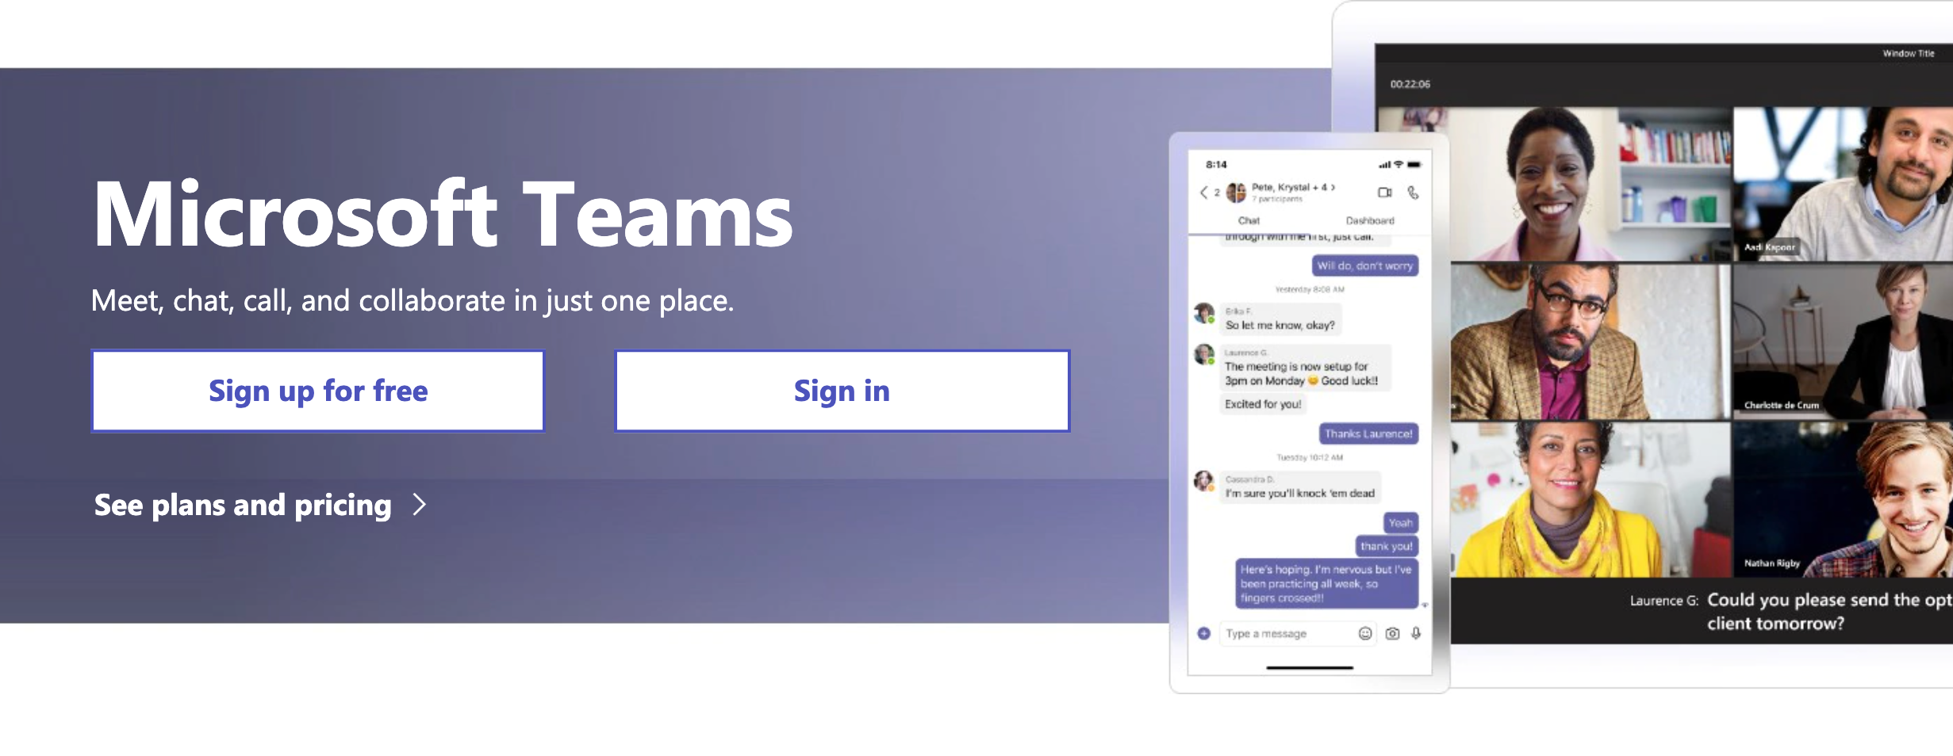
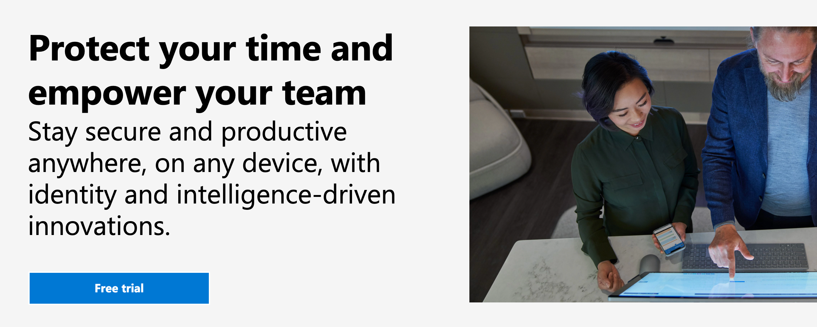
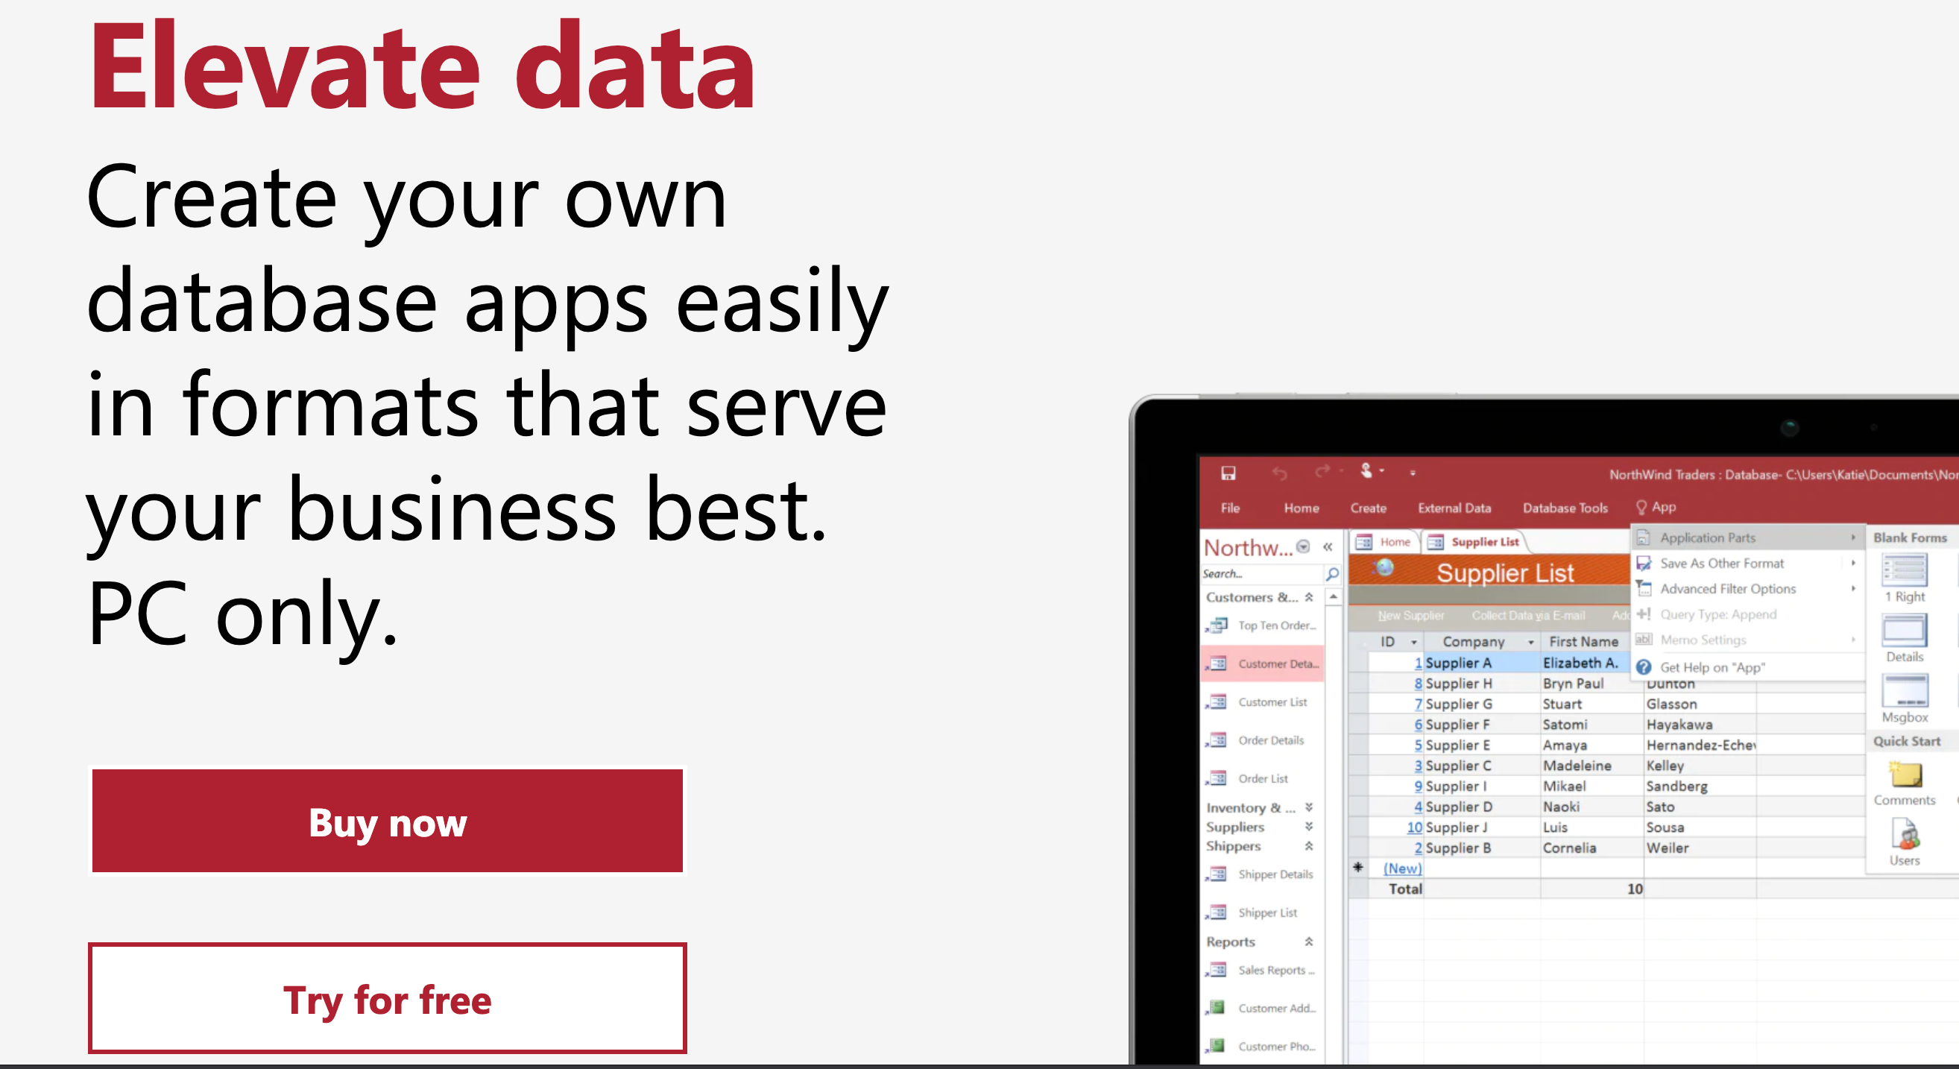
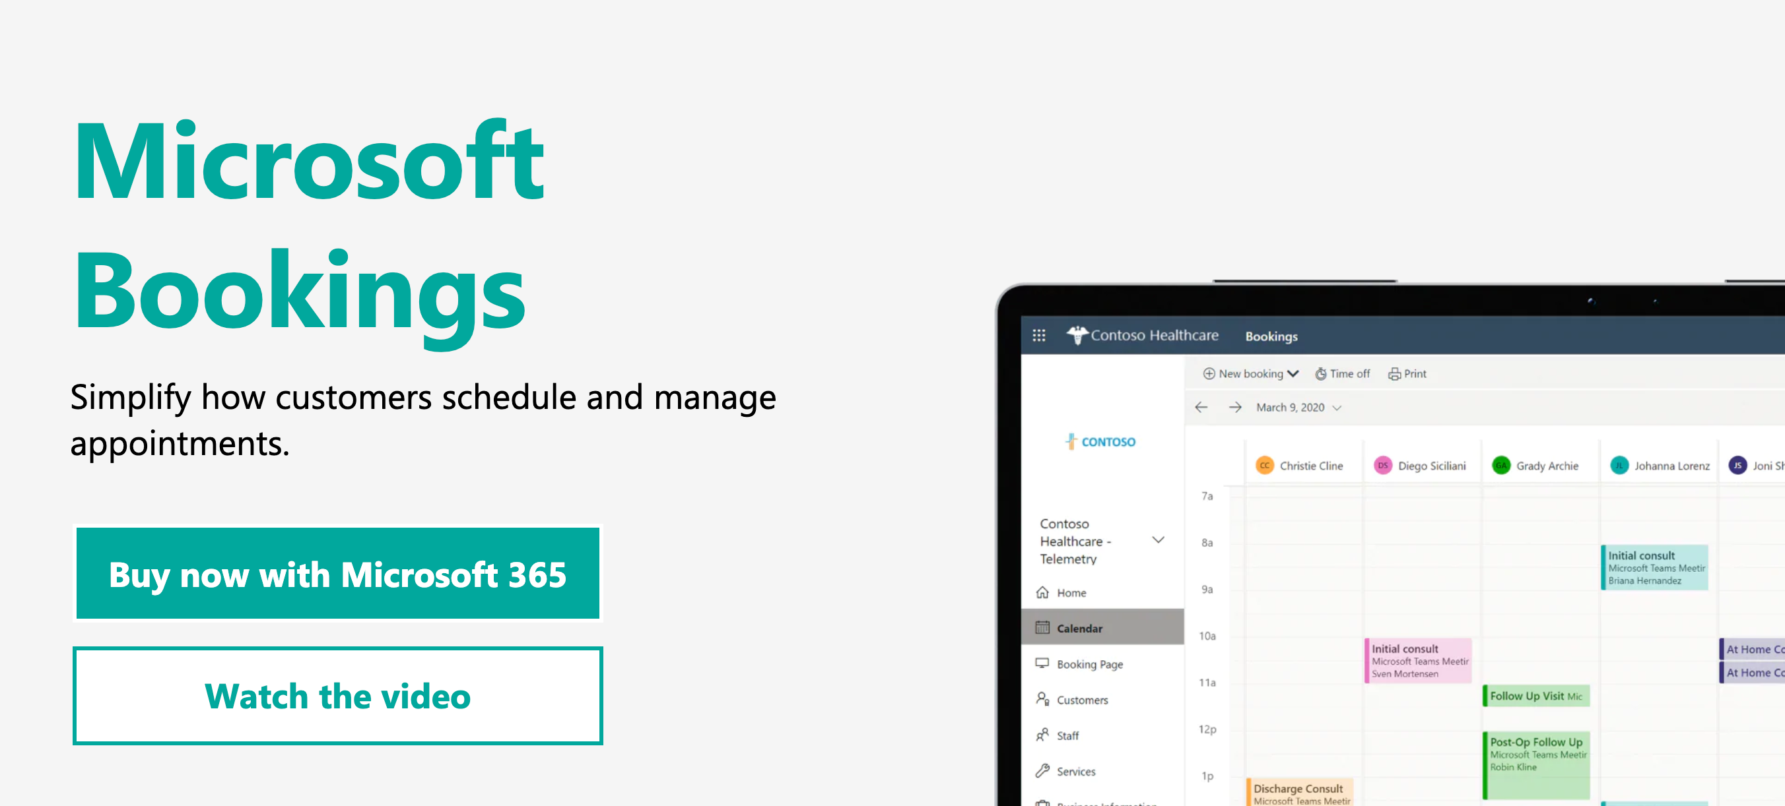
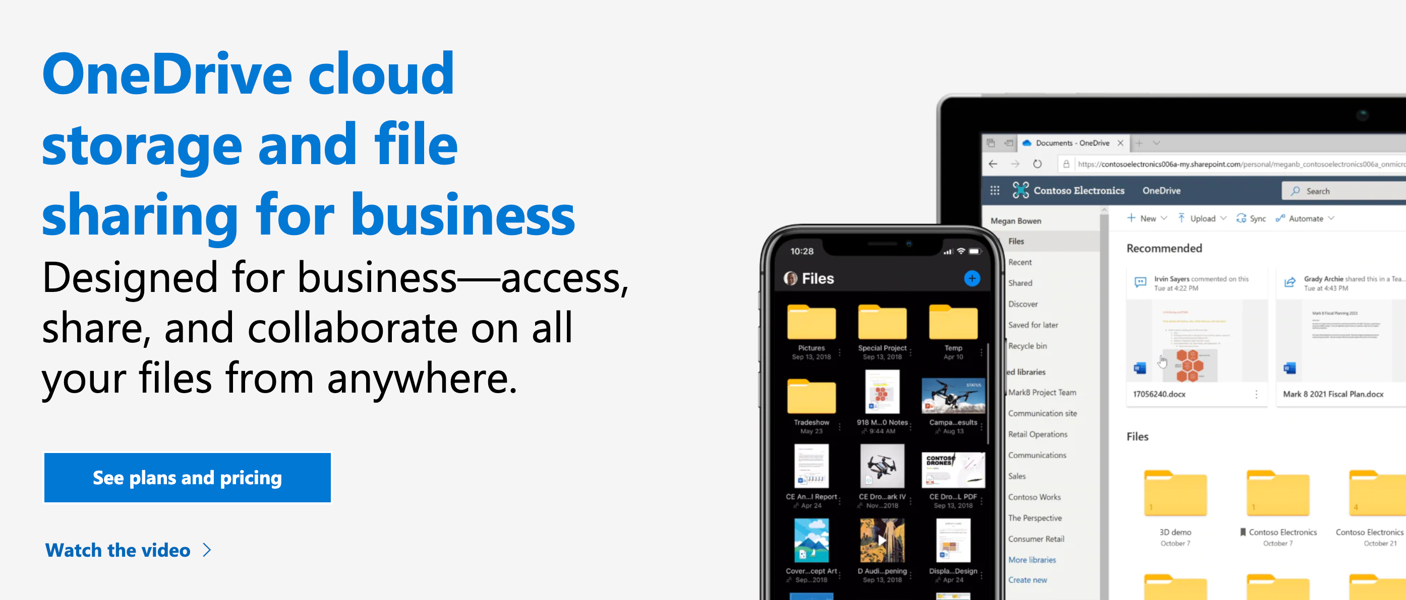
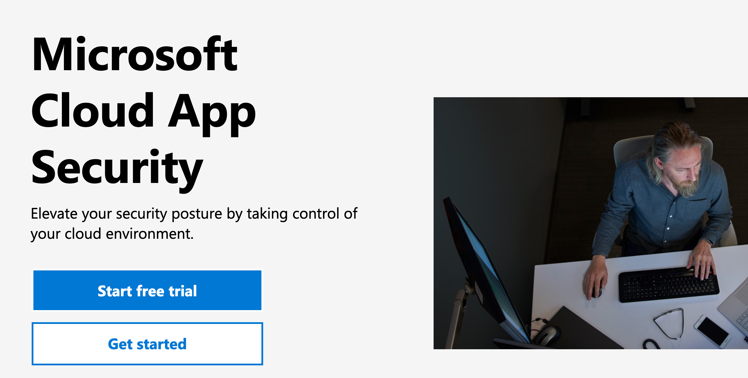
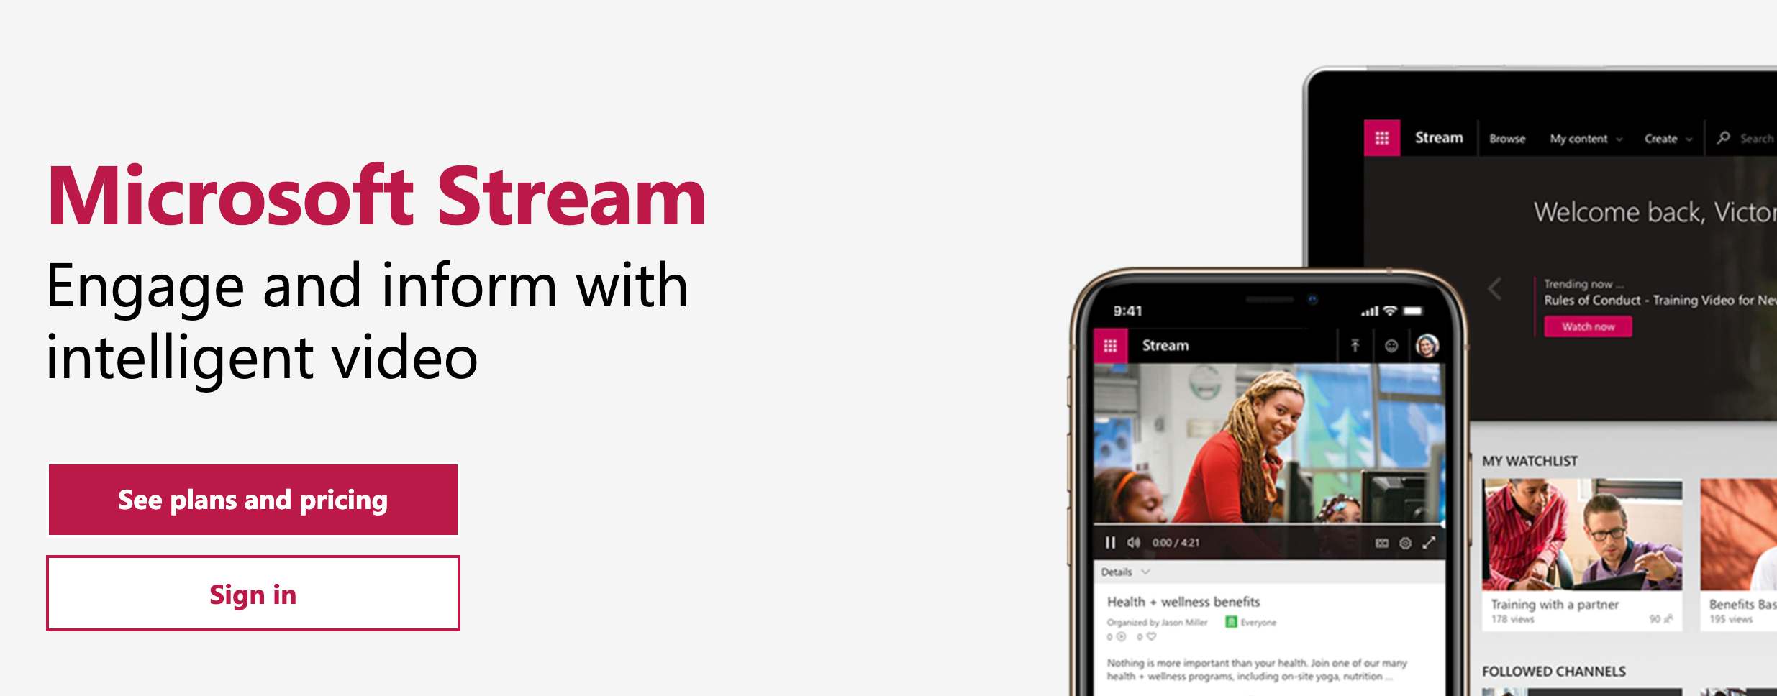
Motivation
So many features to recommend!
Not all such messages are useful for every individual!
Unaffordable or detrimental to run active experiments on all of them!
Split-Treatment!
Use logged behavioral data to identify who are likely to benefit from a novel intervention.
Notes:
many modern applications and devices display educational messages or other recommendations to users, telling them about undiscovered features, advertising related products, or providing other tips that may aid them.
For example, a message recommending an advanced feature may provide significant help to some advanced users, but also confuse and thus harm others.
Standard solution require active experimentation for every new message to select the individual s to assign treatment. Let each individual exposed to detrimental messages can cause negative effects at scale.

Slide 4
Identification of Split-Treatment
Prospective Experimental data
(Expensive, not available)
Observational data
(Cheap, massive, available)
U
X
X
Z
Y
A
Y
Target treatment
Outcome
Ranking-proxy treatment
Outcome
The ultimate goal is to estimate the effect of a prospective treatment Z, but it is not observed.
Alternatively, Split-Treatment estimates the effect of a proxy treatment A.
Under proper assumptions, the ranking of the two heterogeneous effect can be aligned.

Slide 5
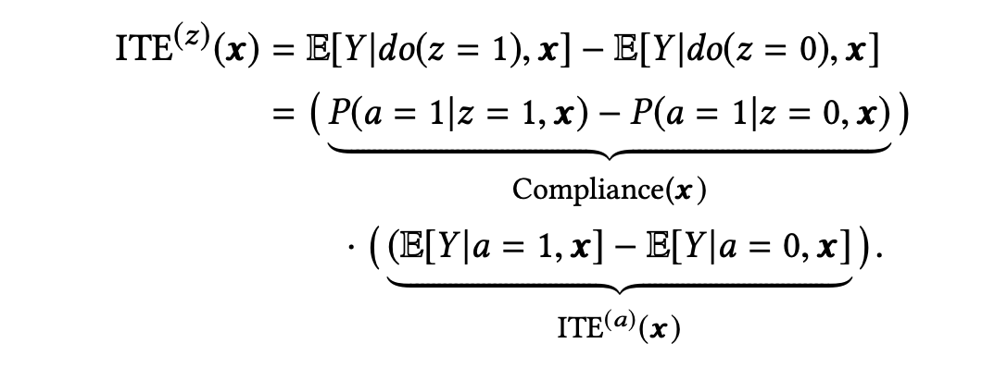
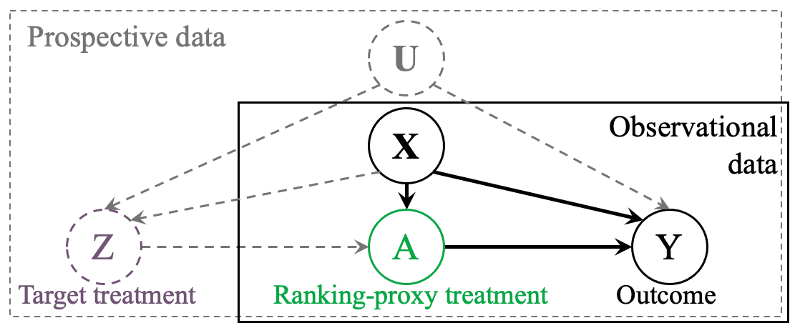
Identification of Split-Treatment
Assumption1 (Ignorability):
Assumption2 (Compliance):
Z: Prospective treatment
A: Proxy treatment
Y: Outcome
X: Observed Confounder
U: No-unmeasured
unobserved Confounder
We pick a proxy treatment A such that:
A exists, with some natural variation, in our observational logs.
The effect of Z on Y should be mediated through A.
Notes:
Briefly tell why they are here, we need reasonable assumptions, look to paper for details
How persuasive the target treatment Z is in encouraging an individual to take a short term user behavior.
The long-term effect of the action
While we cannot know the first part of our split-treatment without performing the prospective intervention, we can identify the second part of it when the action we are encouraging people to take has been performed by others in our non-experimental data.
We assume the target treatment Z has a positive average effect to encourage the proxy treatment A.
the individuals who we identify having positive benefit from the proxy treatment A should most likely be positively affected by the prospective treatment Z
we cannot test this assumption in observational data, so we must use external domain knowledge to ensure the assumption is satistified

Slide 6
Estimation using Split-Treatment
An end-to-end analysis pipeline of using Split-Treatment in feature/product recommendation.
Likely best models
1. Data processing and setup
2. Estimate ITE models
3. Refutation/sensitivity analysis
Validation via
active experiment
Message/rec. tagrgeting
Validation is added only if experimental
data having Z is available.
Notes:
Multiple treatment effect estimation methods will provide varying results about the causal effect. So we provide xxx to evaluate the estimates returned by different methods. We can refute an estimator that is unreliable,

Slide 7
Estimation using Split-Treatment
Observational data
Experimental data containing Z
Pre-treatment
window
Treatment
window
Post-treatment
window
Pre-campaign
window
Campaign
window
Post-campaign
window
Proxy treatment A
Sustained usage Y
Proxy treatment A
Sustained usage Y
Extract features X
Collect outcomes Y
Extract features X
Collect outcomes Y
Target treatment Z
Proxy Treatment A: 1st use of the product in Treatment window.
Target Treatment Z: Message in Campaign window.
Confounding factors X: Extracted from Pre-treatment window till the 1st usage.
Outcome measure Y: Sustained usage of the recommended product in Post-treatment window.
For the purpose of validation
Notes:
This is like experimental setup.
How to pick proxy-treatment?
Say: We were lucky we found this one in our case

Slide 8
Estimation using Split-Treatment
Inverse probability of treatment weighting (IPTW): Predict propensity scores to reweight individual outcome estimates and obtain unbiased ITE.
Given the observational data $D^{n}=\{\left(x_{i}, a_{i}, y_{i}\right)\}$, we learn outcome function f by minimizing the following loss:
with stabilized IPTW:
Notes:
Transition: there are many choices for the features we selected, or params we need to tune; so we need a sens analysis to help us make such decisions
We don’t have ground truth until we run A/B test

Slide 9
Estimation using Split-Treatment
We use sensitivity analyses to eliminate unreliable models in the absence of experimental validation.
Placebo test
Place a random variables as the treatment A
Test if an estimator returns zero causal effect.
Prune out those estimators that show significant non-zero causal effect.
Unobserved-confounding test
Add a new confounder to the feature set with varying degrees of its effect on A and Y.
Test if an estimator is less sensitive to the varying degrees of effect of the new confounder.
Prune out those estimators that are sensitive to such changes
Notes:
One line on top: what the role of sens analysis is. More robust, likely most accurate

Slide 10
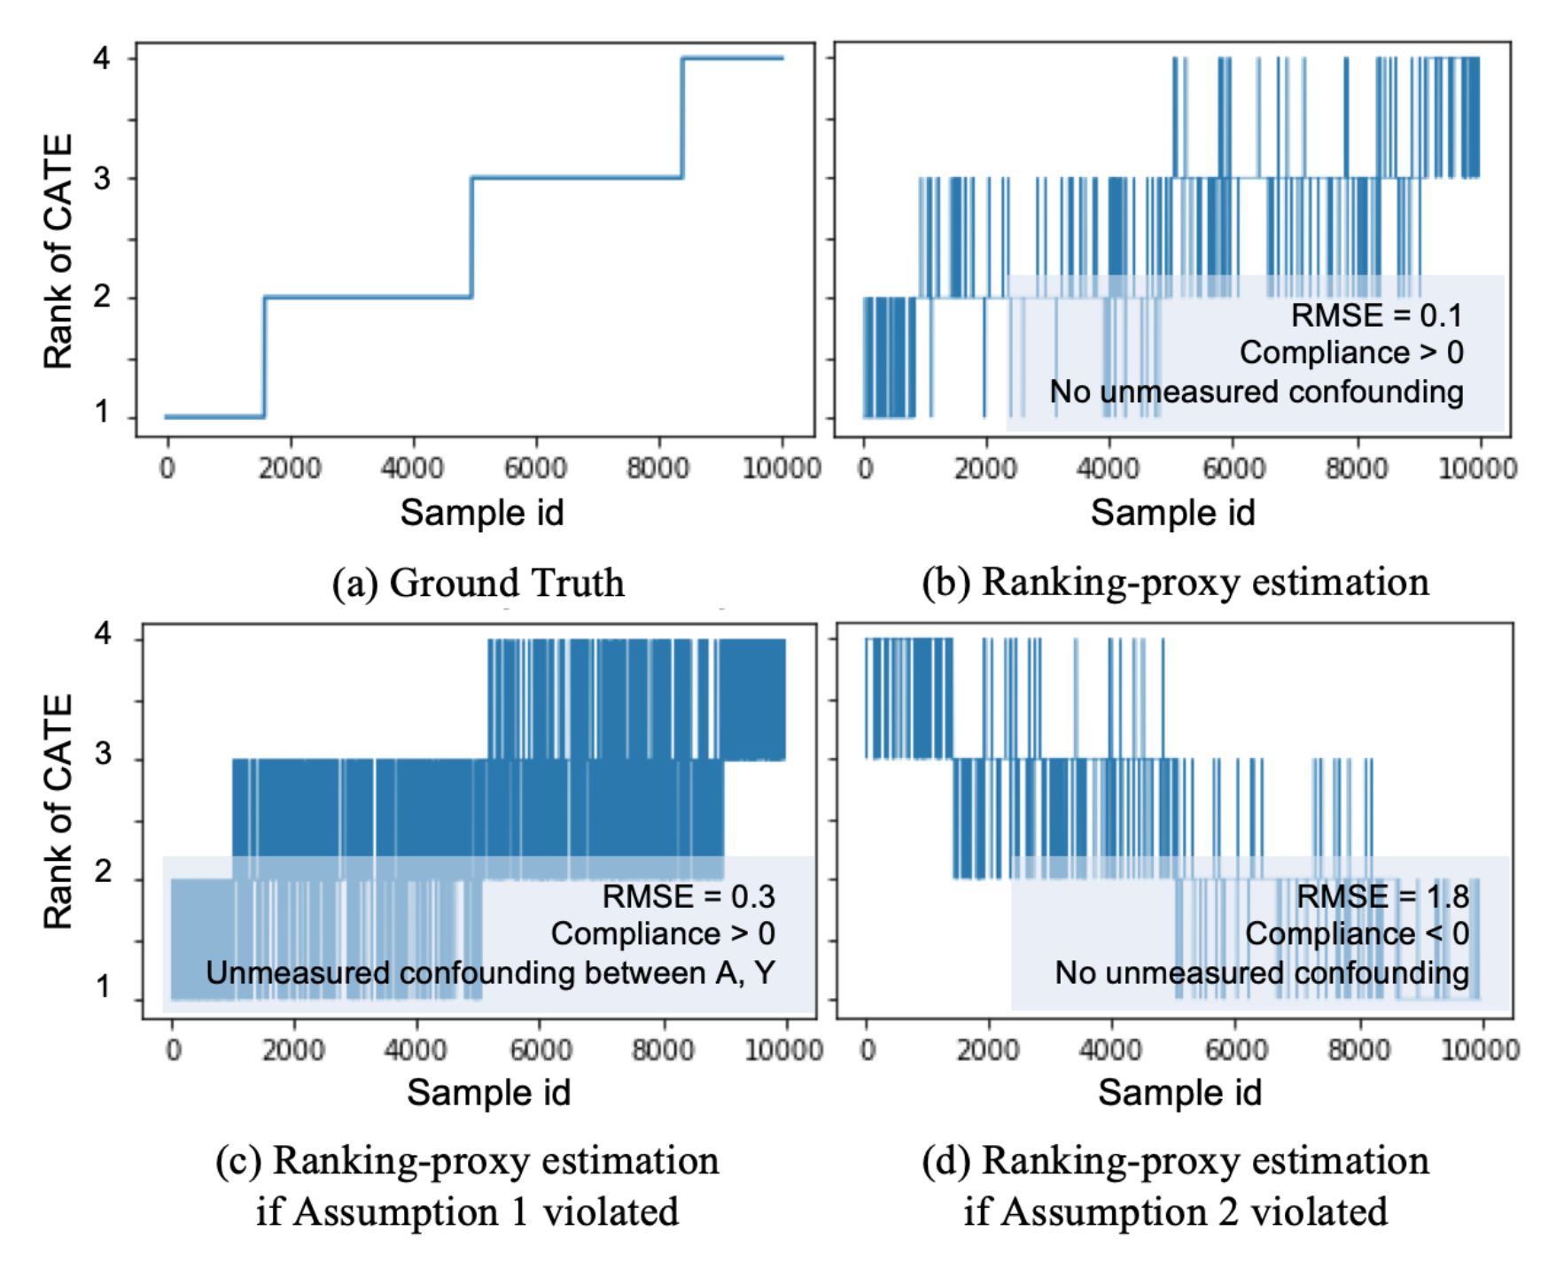
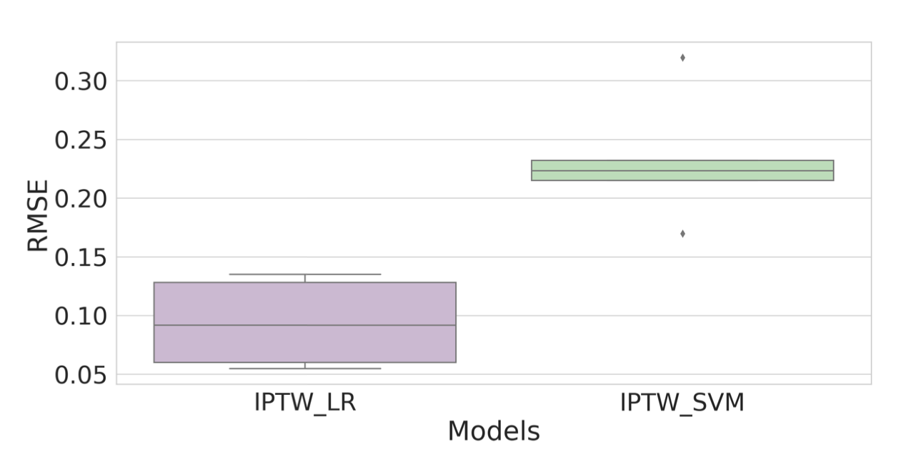
Experiment And Results (Simulation)
Simulation results
IPTW-LR is less sensitive to unobserved confounding. Box plots are for 5 runs with different degrees of confounding.
Violation of the two Assumptions: Comparison between the ground-truth rank and the proxy-estimated rank in simulations with or without violation of the assumptions.
Unobserved-confounding analysis: Comparison between estimated causal effect with and without unobserved confounding, for two causal models.
Notes:
Talk: what do you expect to see, if it’s working well or not well. Idealy (a)

Slide 11
Experiment And Results (Real data)
Real-world data: Product recommendation in a large software ecosystem.
Experimental setup:
Treatment window: 3/29/2019 – 4/27/2019 (1 month) Extract proxy treatment assignments.
Pre-Treatment window: 3/22/2019 – 3/28/2019 (1 week) Extract confounding factors.
Post-Treatment window: 4/28/2019 – 5/24/2019 (4 weeks) Extract outcome measures.
Split treatment:
Proxy treatment A: 1st use of the product in Treatment window.
Outcome Y: Sustained usage of the recommended product in Post-treatment window
Data description:
Observational data: 2.2M
2.3% used the product in the Treatment window
Experimental data (Timeline aligned): 1.1M
66.1% exposed to Z, 5.7% vs. 5.3% used the product from the exposed vs. unexposed group

Slide 12
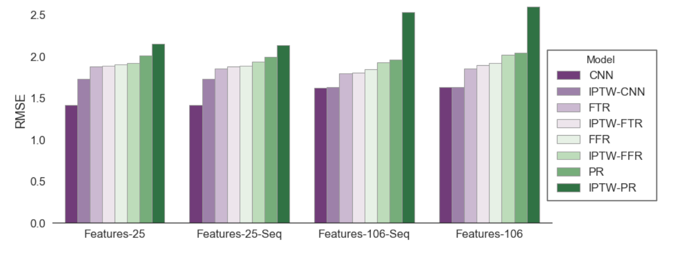
Experiment And Results (Real data)
RMSE of outcome prediction from the baseline models.
FTR (Fast-Tree Regression): An efficient tree regression with gradient boosting
FFR (Fast-Forest Regression): An efficient random forest regression using the Fast-Tree learners.
PR (Poisson Regression): A linear regression with respect to minimizing Poisson loss instead of mean squared errors.
CNN (Convolutional Neural Network): A 2-layer 1-D convolutional network with Poisson loss.
Features-25 and Features-106: two static feature sets
Features-25-Seq and Features-106-Seq: two aggregated sequential feature sets
Notes:
To highlight: lower is better, CNN does the best
Explain why IPTW doesn’t predict better than ML models
This is not a causal task, we will get to that causal evaluation next
Why this is a hard problem: this ML evaluation cannot tell

Slide 13
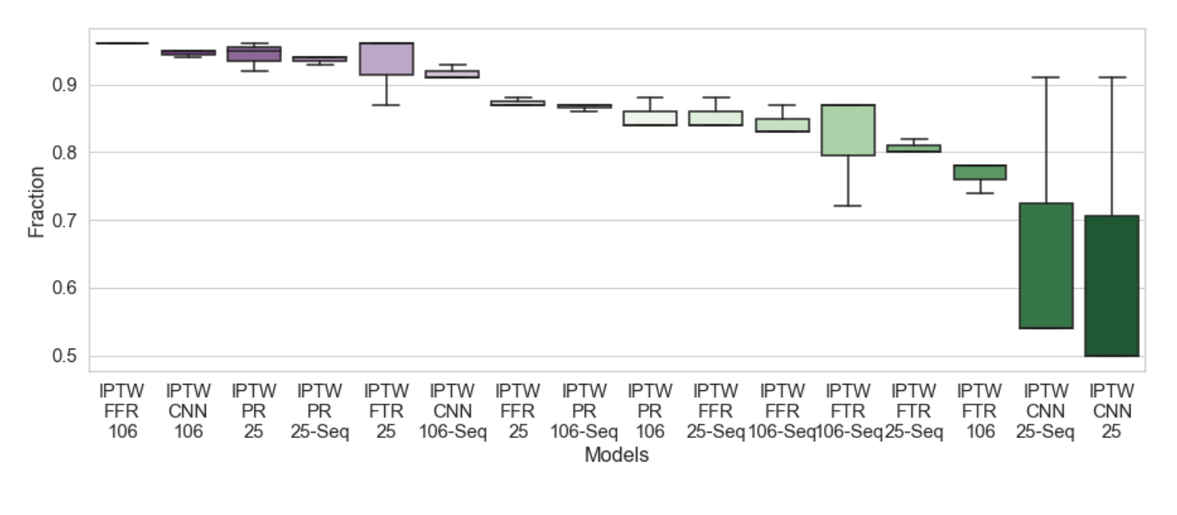
Experiment And Results (Real data)
Sensitivity analysis (unobserved confounding)
Most consistent in ranking;
Least sensitive to the varying degrees of effect on A and Y
Least consistent in ranking;
Most sensitive to the varying degrees of effect on A and Y
Fraction of the top 50-percentile individuals that remain in the top 50-percentile after adding an observed confounder. Box plots are for 3 runs with different degrees of confounding.

Slide 14
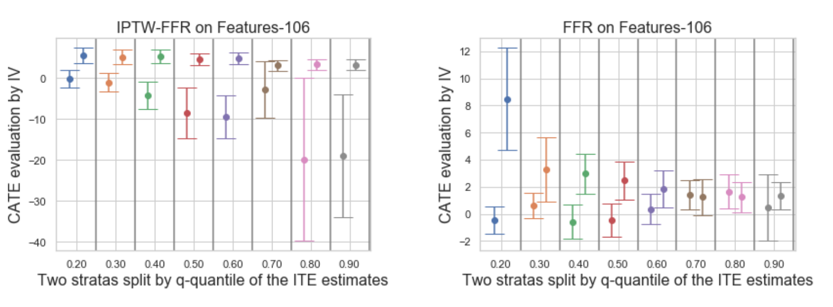
Experiment And Results (Real data)
Validation on experimental data
Best model (IPTW-FFR) picked by the sensitivity analysis
(Non-causal)
Left is NOT consistently (NOT significantly) lower than Right across all the k quantiles.
Left is consistently (mostly significantly) lower than Right across all the k quantiles.
Group ITE estimates by k quantiles and stratify each group into low (left) and high (right) subgroups.
Given the subgroup assignment, run IV analysis on the experimental data.
Use the ground-truth CATE (from IV analysis) to validate:
the low (left) should be consistently lower than the high (right) subgroup across all the k groups!

Slide 15
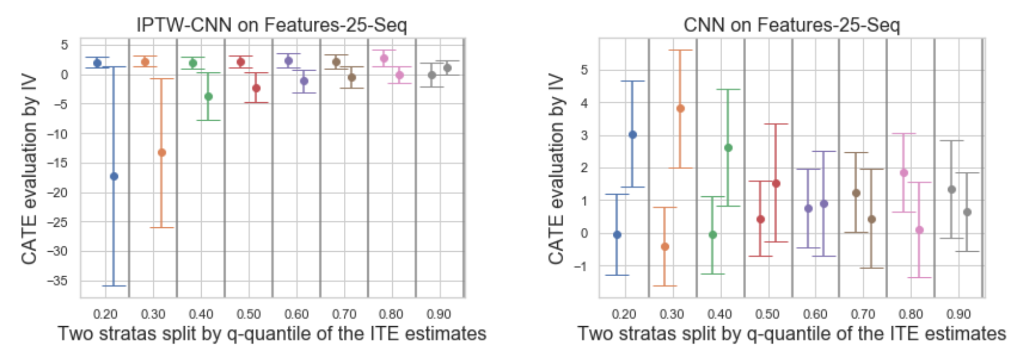
Experiment And Results (Real data)
Validation on experimental data
Worst model (IPTW-CNN) picked by the sensitivity analysis
(Non-causal)
Left is NOT consistently (NOT significantly) lower than Right across all the k quantiles.
Left is consistently (mostly significantly) NOT lower than Right across all the k quantiles.
Group ITE estimates by k quantiles and stratify each group into low (left) and high (right) subgroups.
Given the subgroup assignment, run IV analysis on the experimental data.
Use the ground-truth CATE (from IV analysis) to validate:
the low (left) should be consistently lower than the high (right) subgroup across all the k groups!

Slide 16
Conclusion
We presented a practical, observational analysis pipeline for
Identifying individuals likely to benefit from a novel treatment Z
Using proper causal analysis of existing logs that contain proxy treatment A
A key contribution:
Refutation tests and sensitivity analyses enable a principled a priori identification of the feature selection and elimination of unreliable algorithmic design.
We validated our analysis with an A/B experiment in a large real-world setting.
Notes:
While we may not frequently have the ability to run active experiments in practice, we do run an A/B experiment in this case

Slide 17
Thank you!
Notes:
Add a conclusion slide
Use obs. Before direct message
Key is sens, analys, IV validates the analysis give us the sense which method is gonna be the best

